Slide 1


CUSTOMER BEHAVIOUR ANALYSIS
Vividha Chaudhari
Komal Chaudhari

Slide 2

Part-One

Slide 3
Part-One Outline
Business Scenario
About Data
Data Transformation
Descriptive Statistics
Data Exploration
Hypothesis
Conclusion

Slide 4
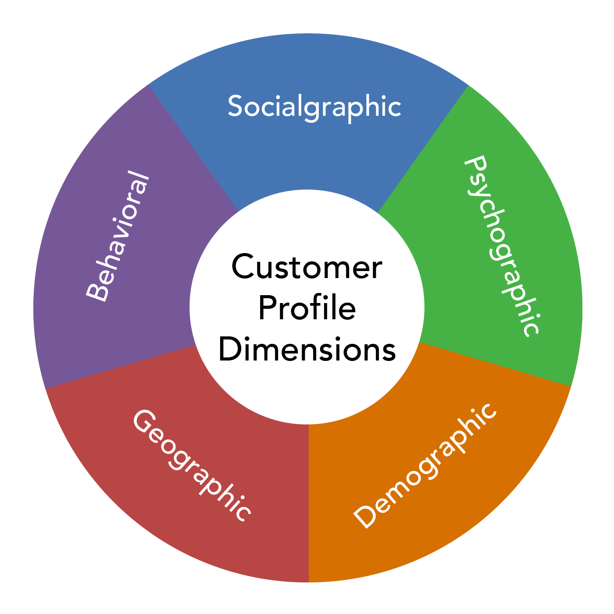
Business Scenario
Customer Behaviour Analysis is a detailed analysis of a company’s ideal customers. It helps a business to better understand its customers and makes it easier for them to modify products according to the specific needs, behaviors, and concerns of different types of customers.
For example, instead of spending money to market a new product to every customer in the company’s database, a company can analyze which customer segment is most likely to buy the product and then market the product only in that segment.
This Photo by Unknown author is licensed under CC BY-SA.

Slide 5
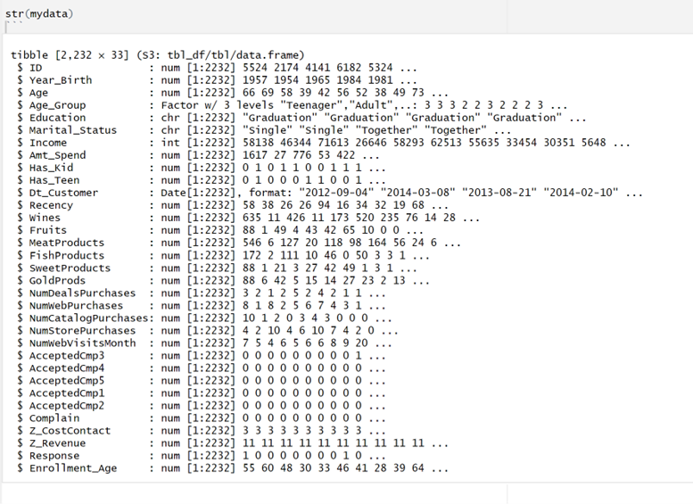
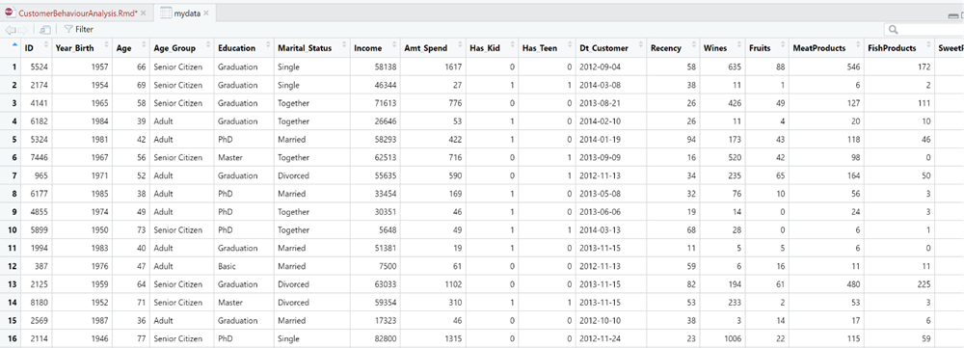
About Data
The dataset analyzed in this project provides a rich source of customer Behaviour information.
Source- https://www.kaggle.com
The data contains 2240 observations and 33 variables.
Demographics, purchase details, campaign buys etc.

Slide 6
Data Transformation
Missing Value Imputation in "Income" Variable:
We addressed by imputing using the median income value.
We choose median because there were outliers in the dataset.
Added Demographic Information:
Utilized "Birth_Year" column to calculate precise customer "Age".
Categorized ages into segments: "Young Adult" (25-40), "Mid-Aged" (41-60), and "Senior Citizen" (61-100).
Utilization of "Dt_Customer" Variable:
Used "Dt_Customer" to derive "Enrollment_Age," representing customer age at initial engagement.
Standardized date format (DD-MM-YYYY) for consistency in analysis.
Introduction of "Amt_Spend" Column:
By aggregating total spending across products ("Wines," "Fruits," "MeatProducts," "FishProducts," "SweetProducts," and "GoldProds").
Notes:
Income- MAR Missing at Random.

Slide 7

Exploring the Data

Slide 8
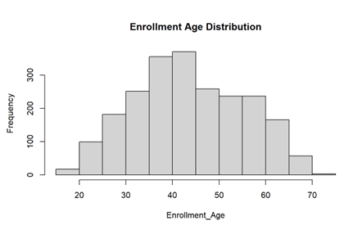
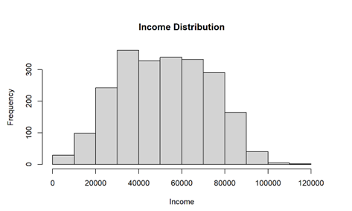
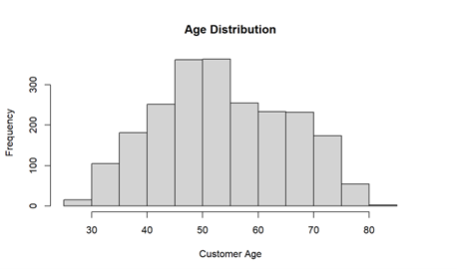
Descriptive Statistics
All three plots are approximately normally skewed.
Notes:
Histogram to check if the data is normally distributed. Age and Income has outliers hence cleaned the data.

Slide 9
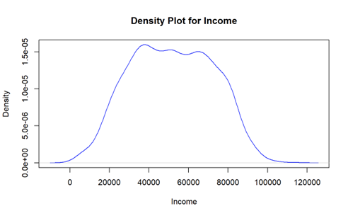
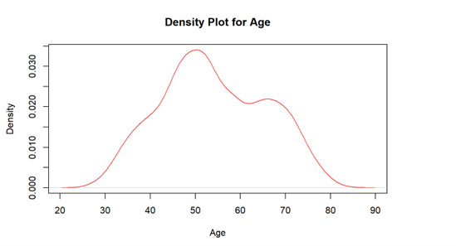
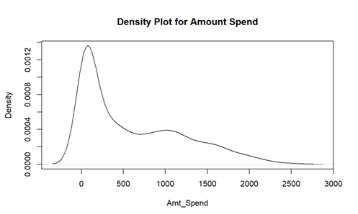
Descriptive Statistics
Income : Multimodal distribution, no skew
Age : Bimodal distribution, no skew
Amount_Spend : Bimodal distribution, right skewed indicating maximum customers spending up to $500. Lognormal distribution.
Notes:
Density Plot

Slide 10
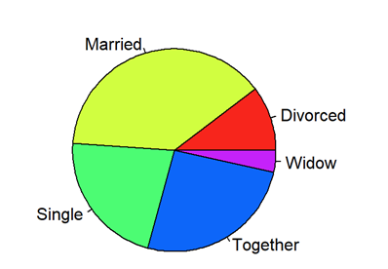
Distribution of Customer Marital Status
The majority of the customer base is comprised of individuals who are married or in relationship, indicating that the products or services might be appealing to this demographic.

Slide 11
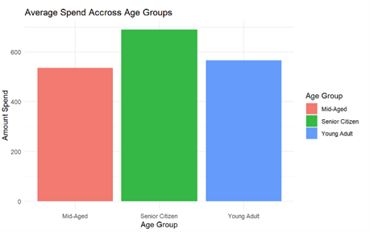
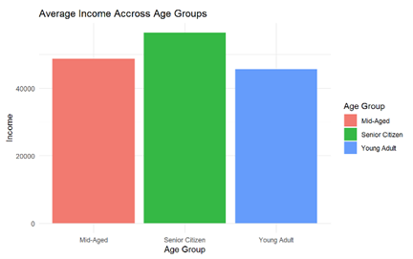
Distribution of Income vs Amount spend with different age groups
The data suggests that the senior citizens earn more as well as they spend more than the mid-aged and young adults.

Slide 12
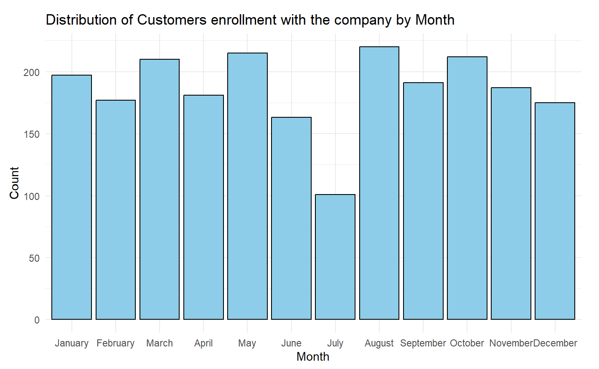
Distribution of Customers' Enrollment with the Company by Month
We observed that June and July exhibited notably lower enrollment compared to other months.
These two months displayed a consistent trend of reduced customer engagement or acquisition within the observed data.
The findings indicate a potential seasonal trend or a particular pattern affecting customer interest or engagement during the mid-year months.

Slide 13
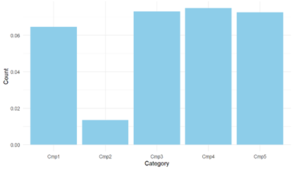
Customer responses to the campaigns
The data suggest that campaign 1, 3 ,4 and 5 has higher responses than campaign 2 indicating successful customer engagement.
There is a further need to investigate what specific elements made the campaign unsuccessful. (month, market condition)

Slide 14
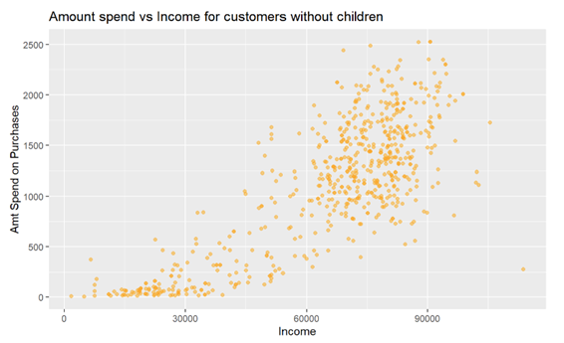
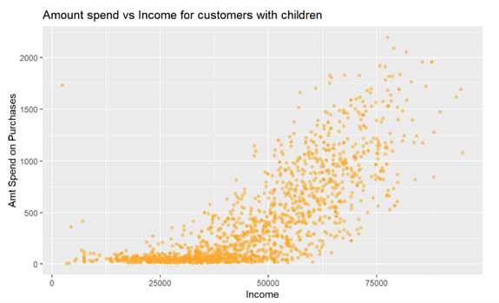
Income vs Amount spend for customers with and without children
The data suggests that the relationship between amount spent, and Income remains the same whether you have any children or not.

Slide 15
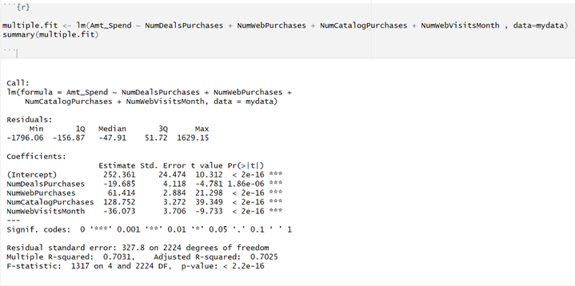
Predicting the amount spend
We run a multiple regression model.
Dependent variable – Amt_Spend
Predictor variable - NumDealsPurchases, NumWebPurchases, NumCatalogPurchases, and NumWebVisitsMonth
This model suggests that the number of web and catalog purchases positively influences Amt_Spend, while the number of deal purchases and web visits per month negatively influence it. The model overall explains a 70.31% of the variance in Amt_Spend.

Slide 16
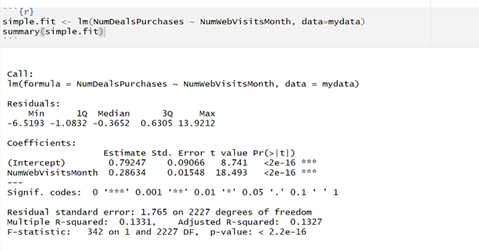
Examining the relationship between NumDealsPurchases and NumWebVisits
We run a simple linear regression model.
This model indicates a statistically significant positive relationship between the variables.
We can say that if the number of website visits increases then the number of deal purchases also increases and vice versa.

Slide 17
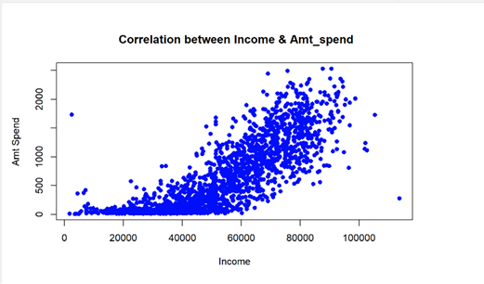
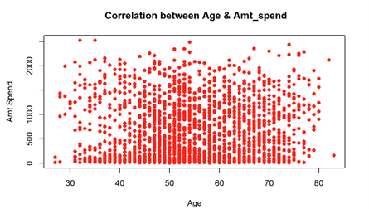
Examining the relationship between Amt_Spend & Income and Amt_Spend & Age
We perform correlation analysis.
There is a strong positive correlation between Income and Amt_Spend with a correlation coefficient of 0.8202216. We can say that if one variable increases, the other variable tends to increase as well, and vice versa.
There is a weak positive correlation between Age and Amt_Spend with a correlation coefficient of 0.1160903.
We can say that younger and older customers both contribute to sales, but the correlation is weak, indicating age is not a significant factor in determining spending patterns.

Slide 18


Slide 19
We want to know if there is a significant difference in the amount spent on wines based on marital status
Null hypothesis: There is no significant difference in the mean amount spent on wines among different marital status categories.
Alternate hypothesis: There is a significant difference in the mean amount spent on wines among different marital status categories.
We conducted ANOVA.
The result contains p-value (0.368) for degrees of freedom 7. As this p-value is greater than the alpha (0.05), therefore we fail to reject the null hypothesis.
We conclude that there is no significant difference in the mean amount spent on wines among different marital status categories.
We can say that marital status does not significantly influence the amount spent on wine.

Slide 20
We want to know if age, income, marital status, having kids or teenagers, education have any impact on Amt_Spend.
Null Hypothesis: The coefficient for predictor variables is equal to zero, indicating no effect on Amt_Spend
Alternative Hypothesis: The coefficient for atleast one predictor variable is not equal to zero, indicating a significant effect on Amt_Spend.
Linear Regression Analyisis.
The regression model suggests that Income, having children (Has_Kid), having teenagers (Has_Teen), and having Basic education significantly (p-value <0.05) influence the amount spent (Amt_Spend).
Other variables, including Age, Marital_Status, and different education levels, do not show a significant impact.

Slide 21
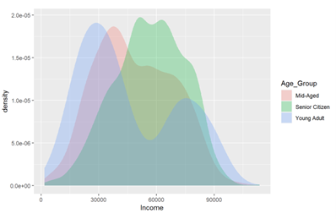
We wanted to test if the income was different for different Age_Groups
Null Hypothesis: The two means are same.
Alternative Hypothesis: The two means are different
We conducted a t-test with categories “Mid-Aged” and “Senior Citizen” as they were normally distributed and filtered category “Young Adult” as it was not normally distributed.
As a result of the t-test we could conclude that the two means are different.
We can say that the Senior Citizens earn more than the Mid-Aged.

Slide 22
Part-One Conclusion
Understanding the predominant marital status can help in deciding the marketing strategies. For instance, we can have campaigns focusing on family-oriented products that might resonate well with married or partnered individuals.
Targeting marketing strategies to appeal to the senior citizens and high-income individuals can exhibit substantial spending habits.
Customers tend to spend more when making web and catalog purchases, while they limit spending during deal purchases and frequent web visits.
Regardless of marital status, customers show similar spending patterns while purchasing wine.
Spending patterns are notably affected by having children and basic education. These factors significantly influence expenditure. However, age, marital status, and varying education levels do not exert a substantial impact on customer spending behavior.

Slide 23

Part-Two

Slide 24
Part-Two Outline
ANOVA
Chi-Square test
Decision Tree Analysis
K-means Clustering
Association Rule

Slide 25
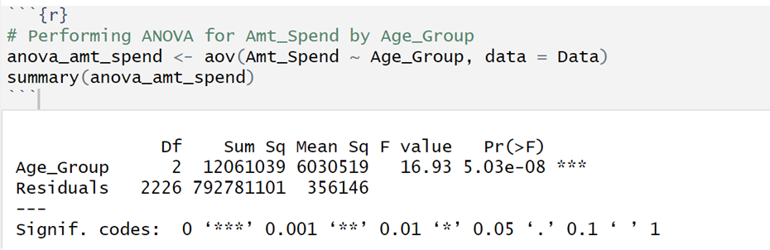
ANOVA: Effect of amount spend on age groups
Null Hypothesis: There is no significant difference in the mean amount spent among different age groups.
Alternative Hypothesis: There is a significant difference in the mean amount spent among different age groups.
Conclusion: The ANOVA results obtained for Amt_Spend ~ Age_Group indicate the statistical significance of the relationship between the categorical variable 'Age_Group' (with three levels: young-adult, senior citizen, mid-aged) and the numerical variable 'Amt_Spend' (amount spent).
The very small p-value (5.03e-08, which is close to 0) indicates strong evidence against the null hypothesis.
It suggests that the average amount spent varies significantly among different age groups

Slide 26
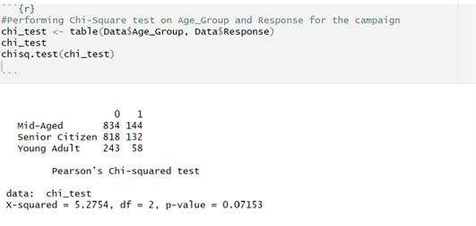
Examining the Association between Age_Group and Response: A Chi-Square Analysis
Null Hypothesis: Categorical variables Age_Group and Response are independent.
Alternative Hypothesis: Categorical variables Age_Group and Response are dependent.
Conclusion: The obtained p-value (0.07153) is more than the significance level of 0.05, indicating that we fail to reject the null hypothesis and conclude that Age_Group and Response are independent. It means that the Age_Group do not influence the Response towards the campaign.

Slide 27
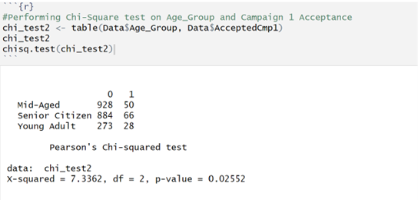
Examining the Association between Age_Group and AcceptedCmp1: A Chi-Square Analysis
Null Hypothesis: Categorical variables Age_Group and AcceptedCmp1 are independent.
Alternative Hypothesis: Categorical variables Age_Group and AcceptedCmp1 are dependent.
Conclusion: The obtained p-value (0.02552) is less than the significance level of 0.05, indicating that there is sufficient evidence to reject the null hypothesis. Therefore, we can conclude that there is a significant association between the variables.

Slide 28
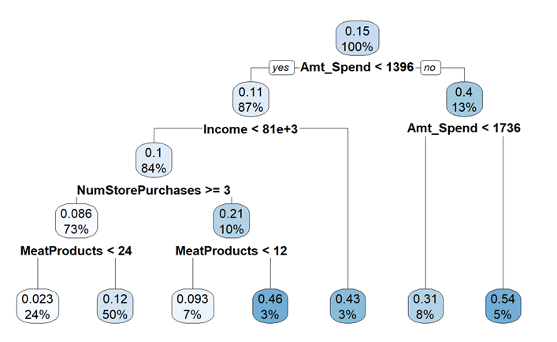
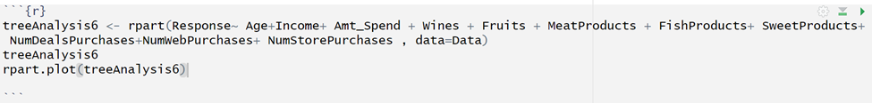
Decision Tree Analysis
Aims to predict the 'Response' based on various customer attributes like 'Amt_Spend,' 'Income,' and purchase behavior such as 'NumStorePurchases,' 'MeatProducts,' etc.
Customers with lower Amt_Spent tend to have lower probabilities of the desired Response.
For customers spending less Amt_Spend and those with lower income tend to have lower probabilities of the Response.
Higher NumStorePurchases and specific product purchases like MeatProducts impact the likelihood of the Response.
Certain purchase thresholds like MeatProducts > 23.5 associate with a higher probability of the Response.

Slide 29
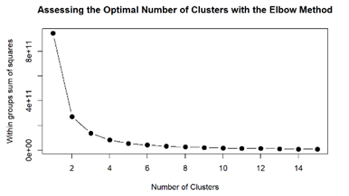
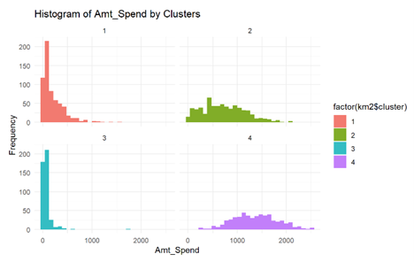
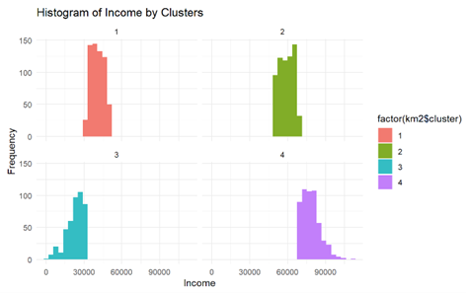
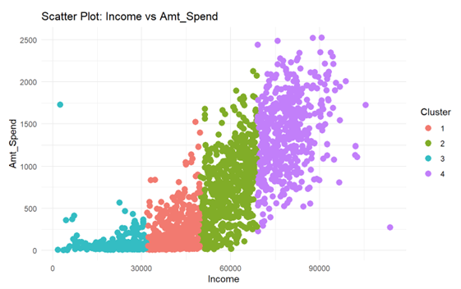
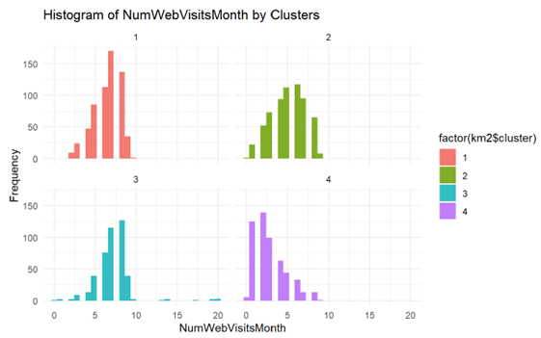
K-means Clustering
Clustering on all numerical variables. Optimal number of clusters 4 as per the graph.
Clusters 2 and 4 spend more amount on purchases as compared to clusters 1 and 3.
Cluster 2 and 4 are the high-income clusters and 1 and 3 are the low-income clusters.
Clusters 1 and 3 visits the website frequently but they do not buy that often as compared to cluster 2 and 4.

Slide 30
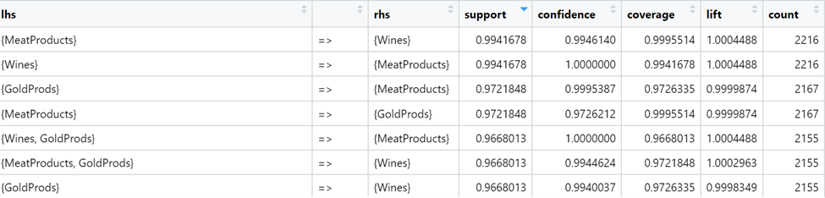
Association Rule
Exploring Association Rules Among Key Product Purchases
MeatProducts and Wines often appear together in transactions, showing a strong occurrence rate.
When MeatProducts are purchased, there's a high confidence that Wines will also be purchased, and vice versa.
Associations like GoldProds => MeatProducts or Wines, GoldProds => MeatProducts indicate a considerable tendency for customers buying GoldProds to also buy MeatProducts, showcasing a strong association between these items.
The lift value implies that MeatProducts and Wines have a moderate influence or connection with each other.

Slide 31
Part-Two Conclusion
Lower spending customers, particularly with lower income, tend to exhibit lower probabilities of the desired Response to campaign.
Meanwhile, higher spending customers and specific purchase behaviors contribute to higher probabilities of the Response to campaign.
Customer visiting the website more often do not associate with a positive influence on amount spend.
Understanding the strong association between MeatProducts and Wines can optimize targeted promotions or product placements for increased sales and customer satisfaction.

Slide 32

Any Questions?

Slide 33
Thank you!!

